Slide 1
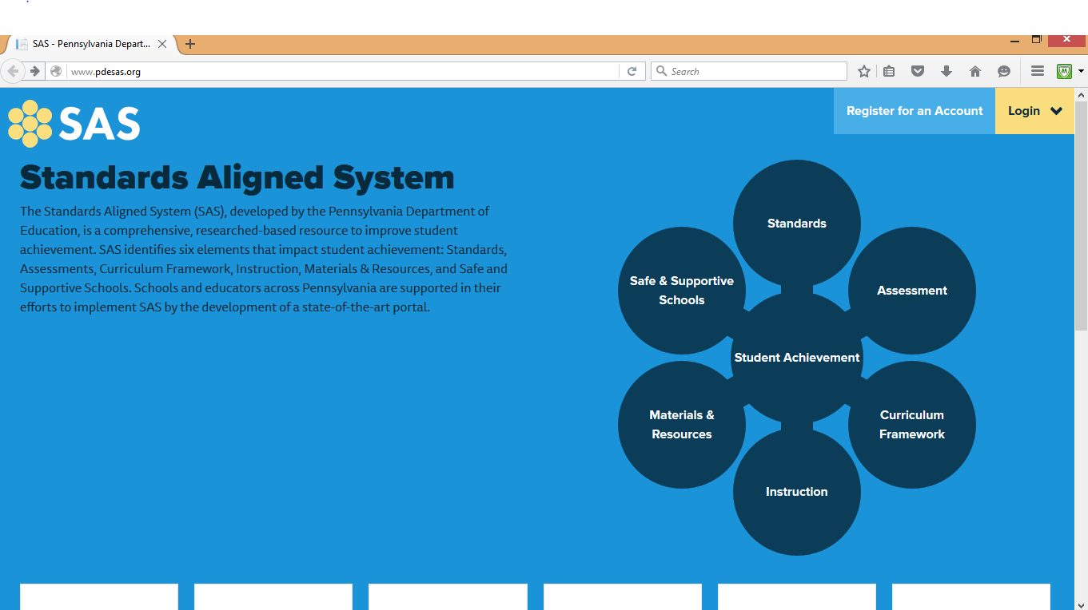

Slide 2
Rate your knowledge ~ Six Elements of the Standards Aligned System (SAS)
I am familiar with the six elements of a standards aligned system.
I can list and define the six elements of a standards aligned system.
I can navigate proficiently on the SAS portal.
I am familiar with the standards coding and assessment anchor coding.
I am familiar with the resources on SAS.
*I have already joined SAS and am a registered user!
Notes:
Participants rated themselves by holding up 1,2,3, or 4 fingers.

Slide 3
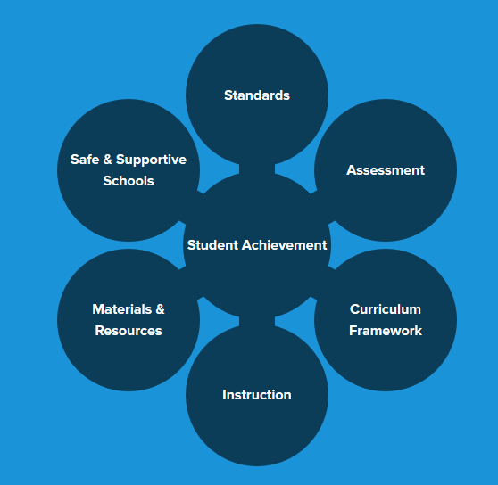
Six Elements of SAS http://www.pdesas.org/
The Standards Aligned System (SAS), developed by the Pennsylvania Department of Education, is a comprehensive, researched-based resource to improve student achievement. SAS identifies six elements that impact student achievement: Standards, Assessments, Curriculum Framework, Instruction, Materials & Resources, and Safe and Supportive Schools. Schools and educators across Pennsylvania are supported in their efforts to implement SAS by the development of a state-of-the-art portal.
Notes:
A brief overview of the 6 elements, will go into detail in module 2

Slide 4
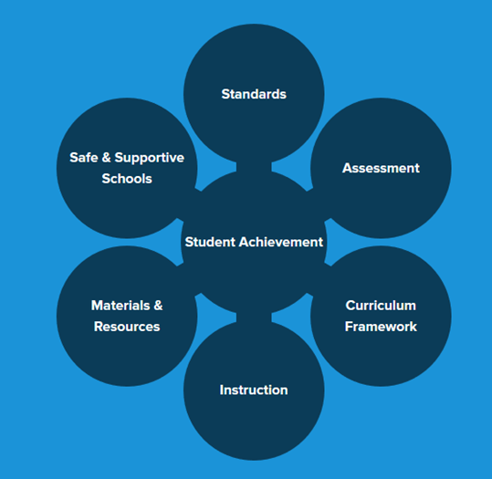
Standards
Describe what all students should know and be able to do as a result of instruction
Increase in complexity and sophistication as students progress through school
Can locate specific PA Core Standards, anchors, and eligible content based on subject area, grade level, or course
Can be downloaded from this portal

Slide 5
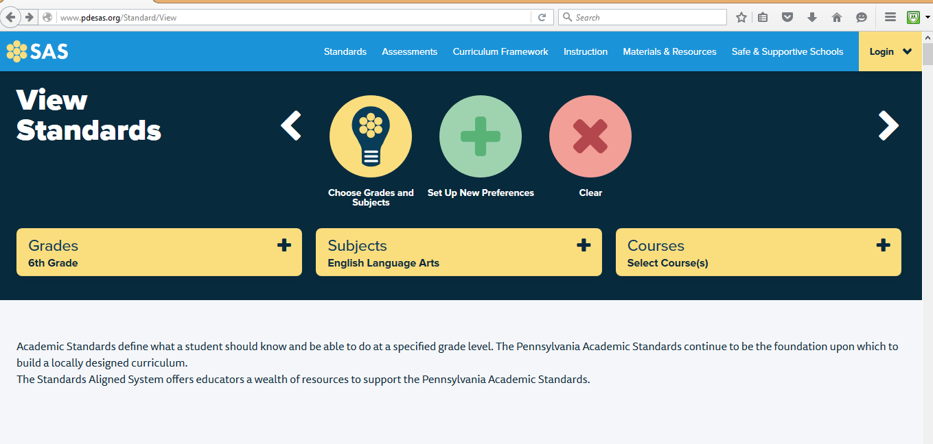
How Can I locate the PA Core
Standards and What do they Look Like?
Notes:
The PA Common Standards are found in the Standards Aligned System (SAS) . SAS is the Pennsylvania Department of Education’s comprehensive approach to support student achievement across the Commonwealth. SAS is a collaborative product of research and good practice that identifies six distinct elements which, if utilized together, will provide schools and districts a common framework for continuous school and district enhancement and improvement. The SAS portal is designed to organize and deliver educational content carefully aligned to the PA Academic and Common Core Standards and provide educators with integrated classroom tools to enhance their teaching effectiveness. SAS identifies 6 elements that impact student achievement: Standards, Assessments, Curriculum Framework, Instruction, Materials & Resources, and Safe and Supportive Schools. Today, we will be focusing on Standards element/tab.
Both registered and non-registered users can access the SAS portal. Parents – if non-registered, can view all 6 elements, including their accompanying tabs, materials and resources

Slide 6
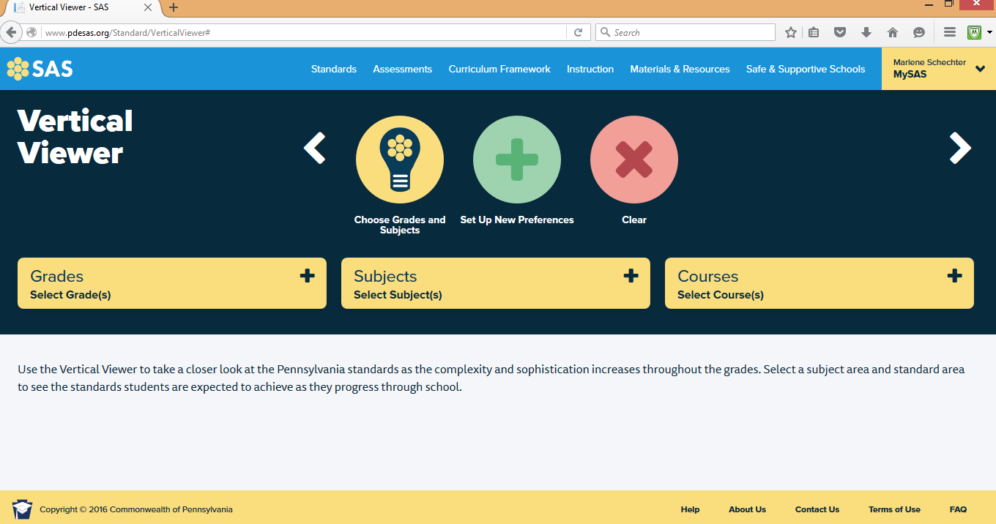

Slide 7
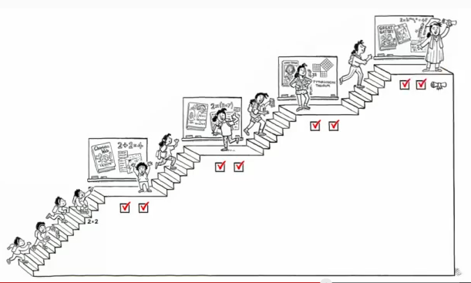
Understanding the Common Core
https://www.youtube.com/watch?v=5s0rRk9sER0

Slide 8

Common Core is about what students should KNOW and be able to DO
Notes:
A critical aspect of the common core is that it is a guide for what students should know and be able to do.
It is not to be confused with a curriculum – which is designed by a school district. The Common core standards let districts know what kids should know and be able to do at each grade level. This ensure consistency across the Commonwealth – and more importantly, across the country. Think about a student who is in 3rd grade in one district and moves across the county line to a new district. It is reassuring that the learning that will take place is consistent with the school from where they came. The PA common core helps make this happen – by ensuring a consistent expectation of what students should know and do at each grade level.

Slide 9
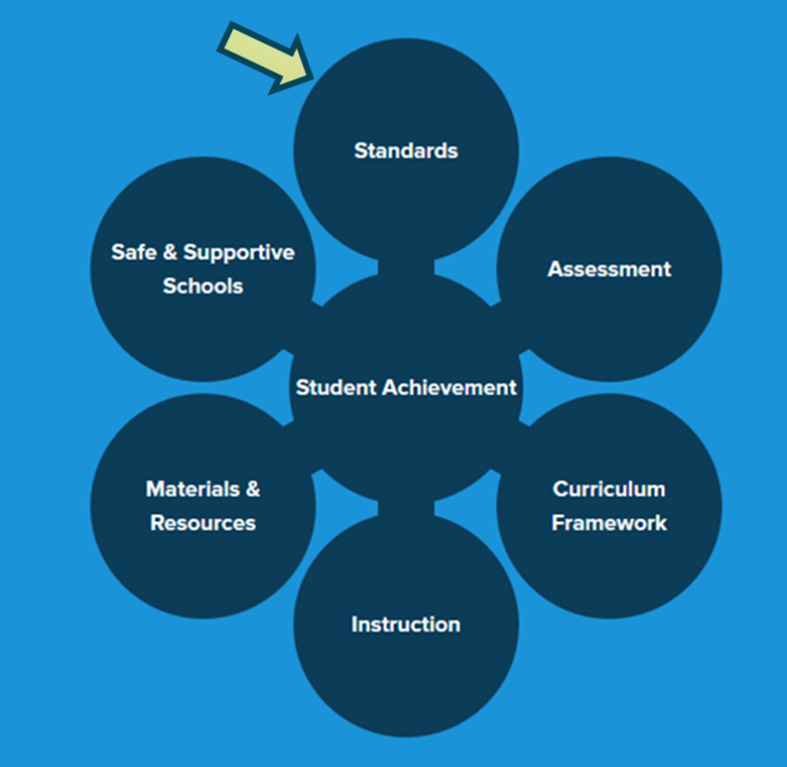

How Can I Use ‘Standards’ in my teaching?

Slide 10
Assessment
Process used by teachers and students before, during, and after instruction
Types of assessment:
  Summative (PSSA, Keystone)
  Formative
  Benchmark
  Diagnostic (Classroom Diagnostic Tool)
Project Based Assessment
Assessment Builder

Slide 11
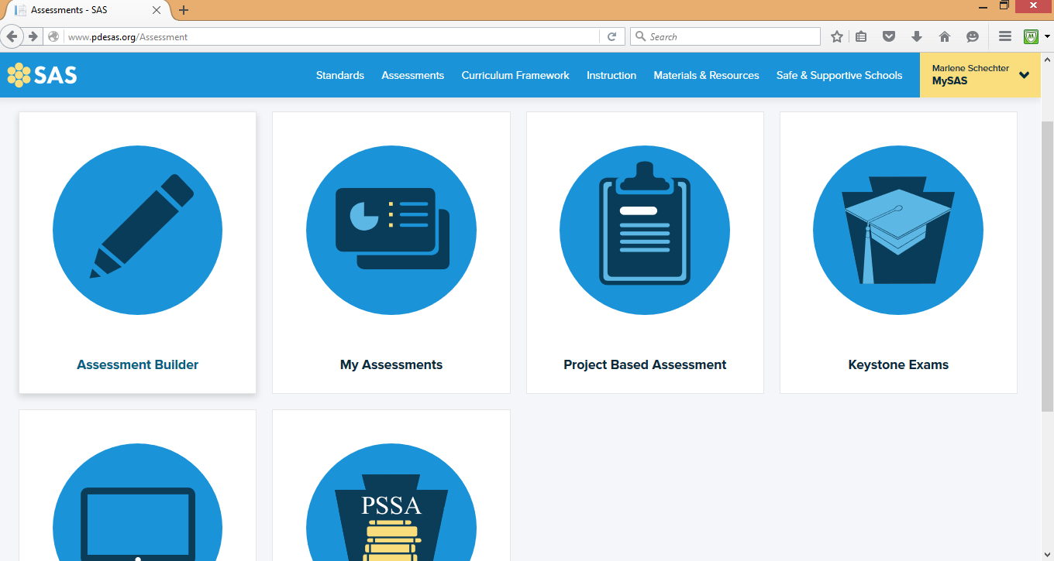

Slide 12
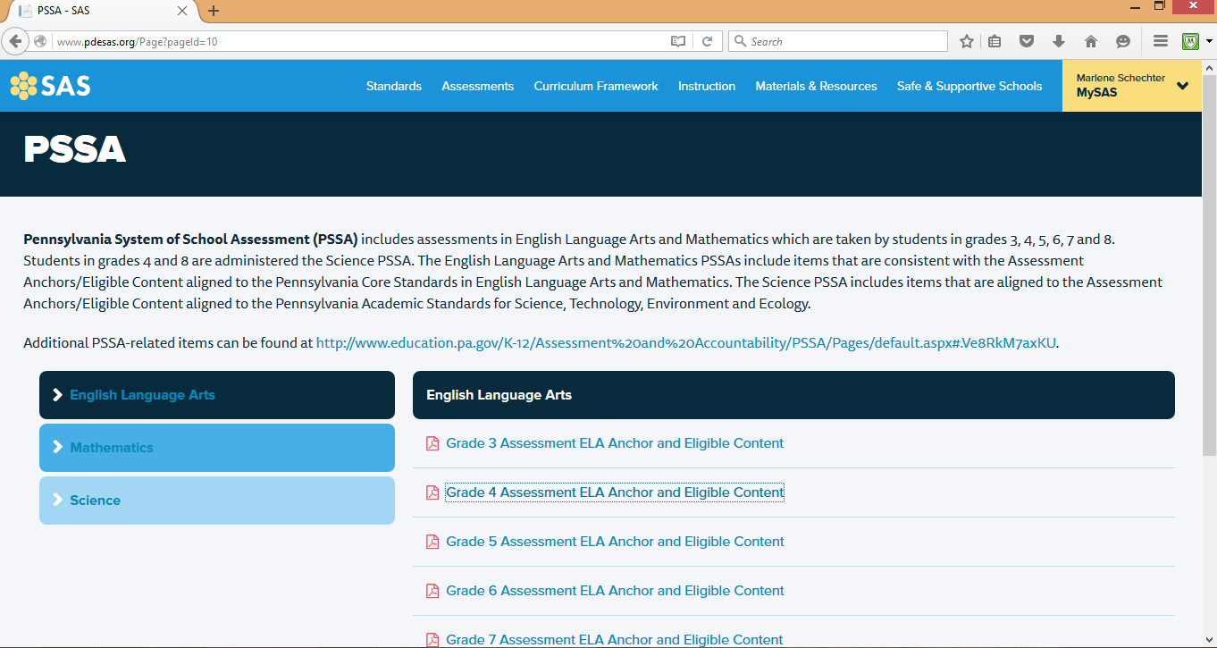

Slide 13
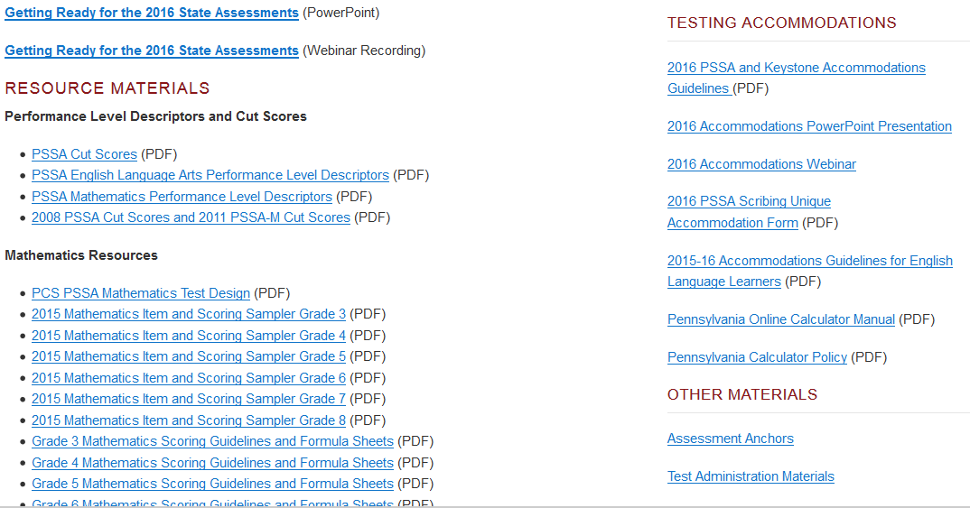

Slide 14
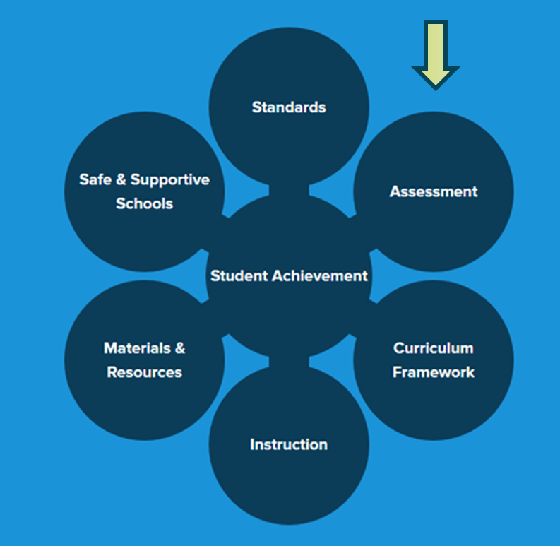
How Can I Use ‘Assessment’ in my teaching?

Slide 15
Curriculum Framework
Specifies what is to be taught for each subject in the curriculum
In PA, Curriculum Frameworks include:
  Standards
  Big Ideas
  Concepts
  Competencies
Essential Questions (aligned to Standards and Assessment Anchors and, where appropriate, Eligible Content)
ELL Overlays
Curriculum Maps

Slide 16
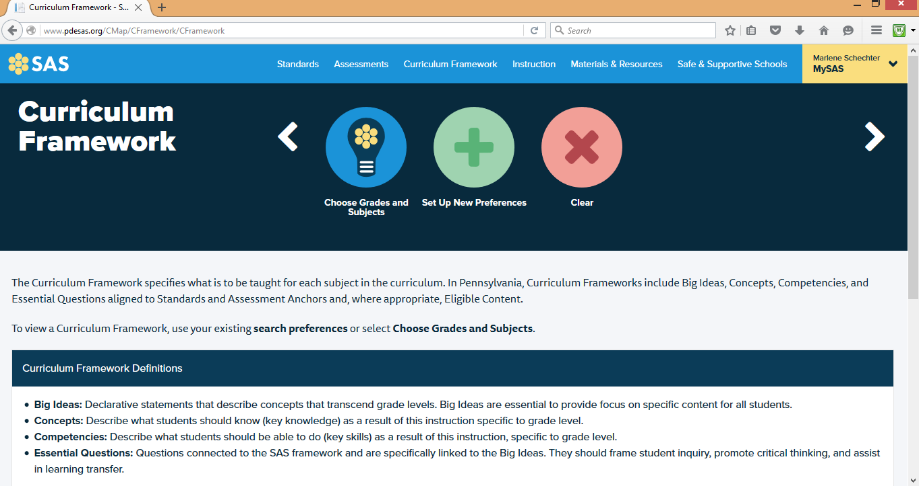

Slide 17
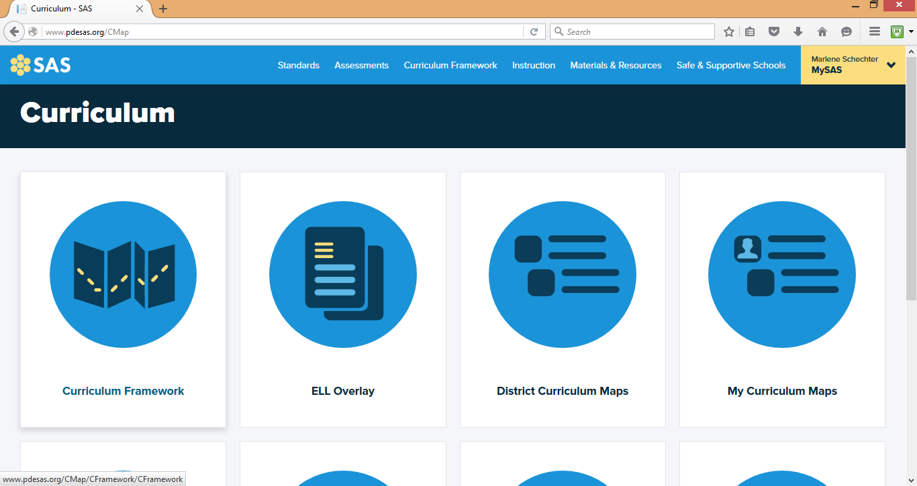

Slide 18
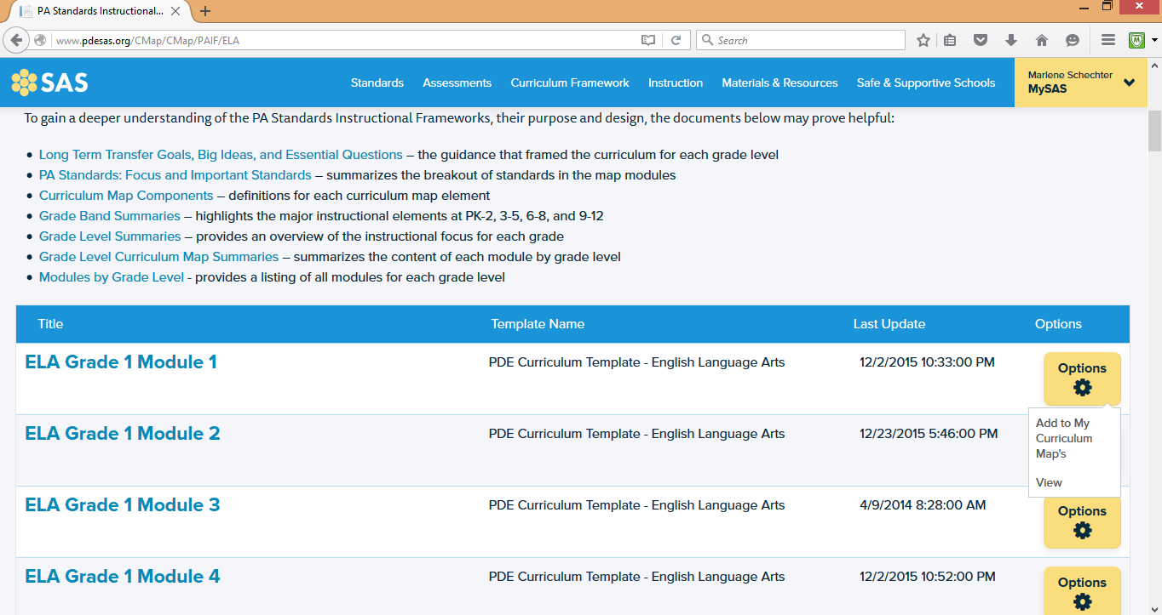

Slide 19
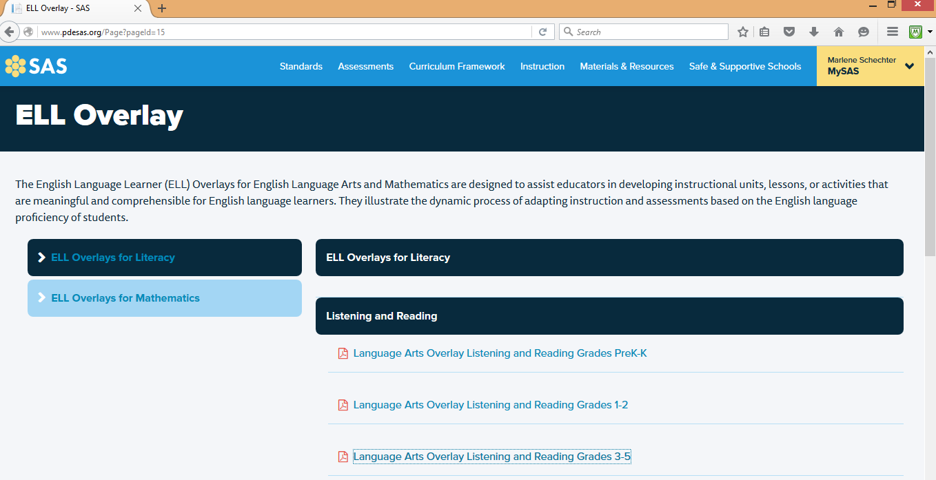
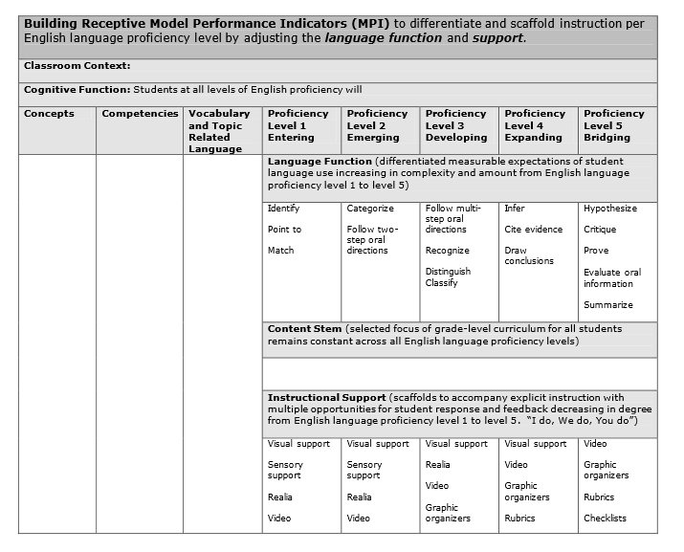

Slide 20
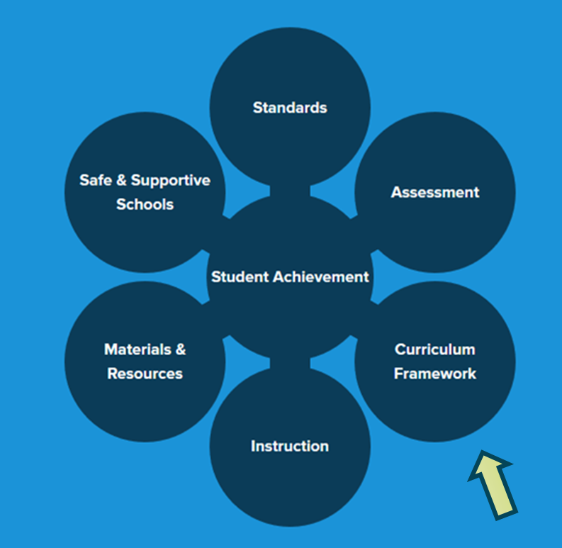
How Can I Use ‘Curriculum Framework’ in my teaching?

Slide 21
Instruction
PA has adopted Charlotte Danielson's Framework for Teaching as the overarching vision for effective instruction in the Commonwealth. The model focuses the complex activity of teaching by defining four domains of teaching responsibility:
  Planning and preparation
  Classroom environment
  Instruction
  Professional responsibilities
Student Learning Objectives

Slide 22
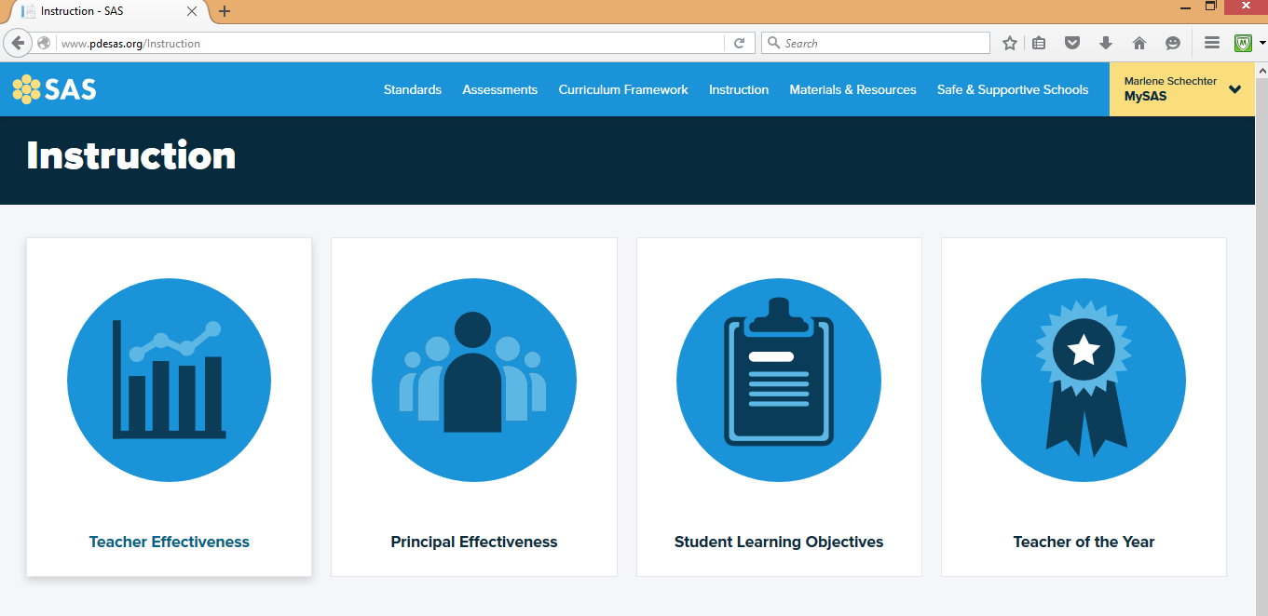

Slide 23
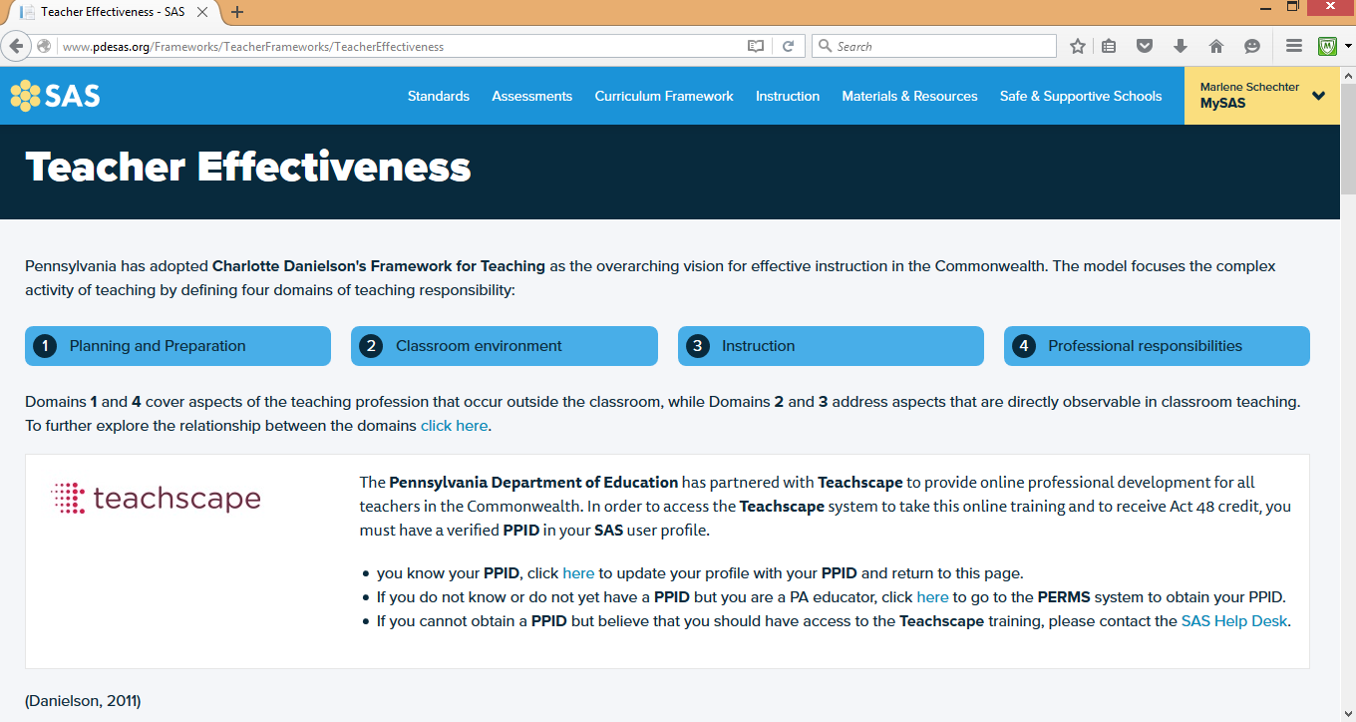

Slide 24
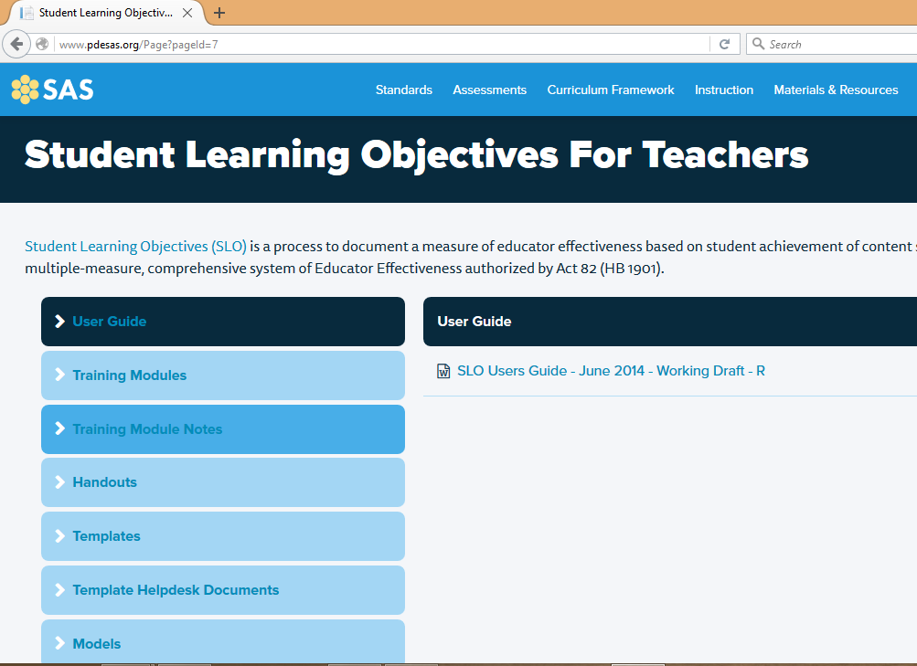
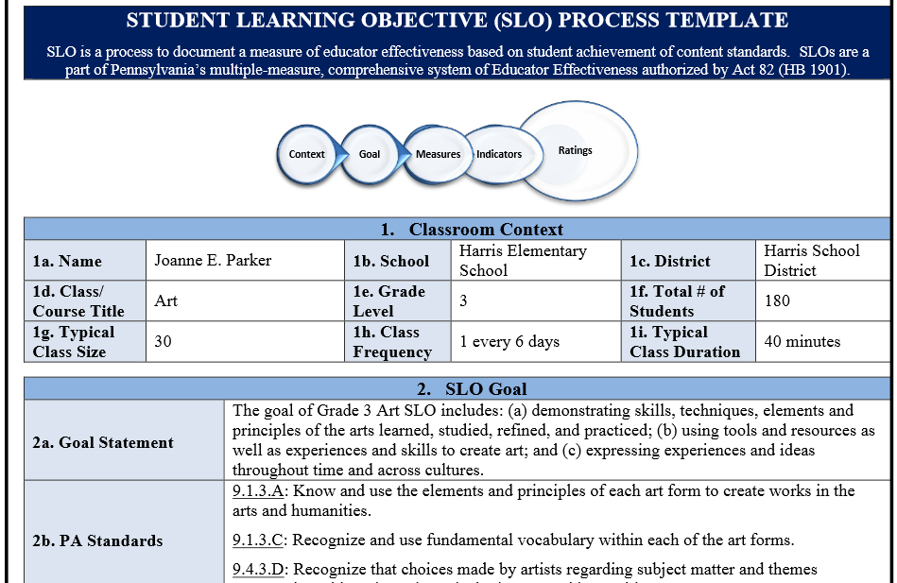

Slide 25
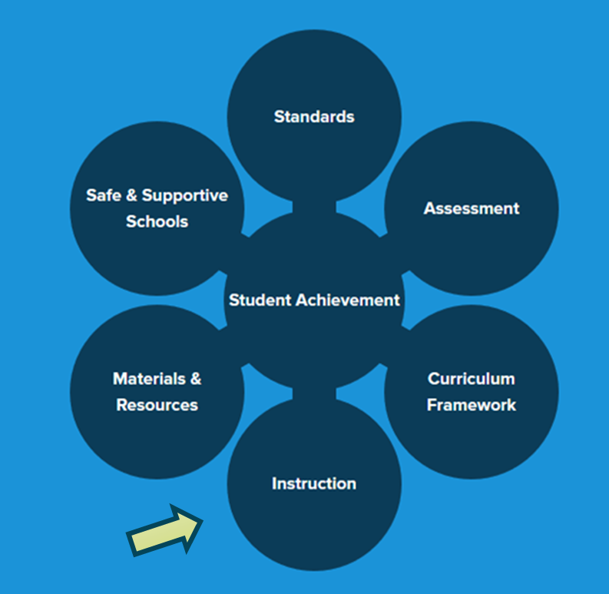
How Can I Use ‘Instruction’ in my teaching?

Slide 26
Materials and Resources
Materials and Resources provides a way to locate standards-aligned content through a targeted search.
Locate educational resources by Keyword, Subject Area/Grade Level, Course, or by one or more specific Content Types.
Find unit plans, lesson plans, and assessments in the Voluntary Model Curriculum

Slide 27
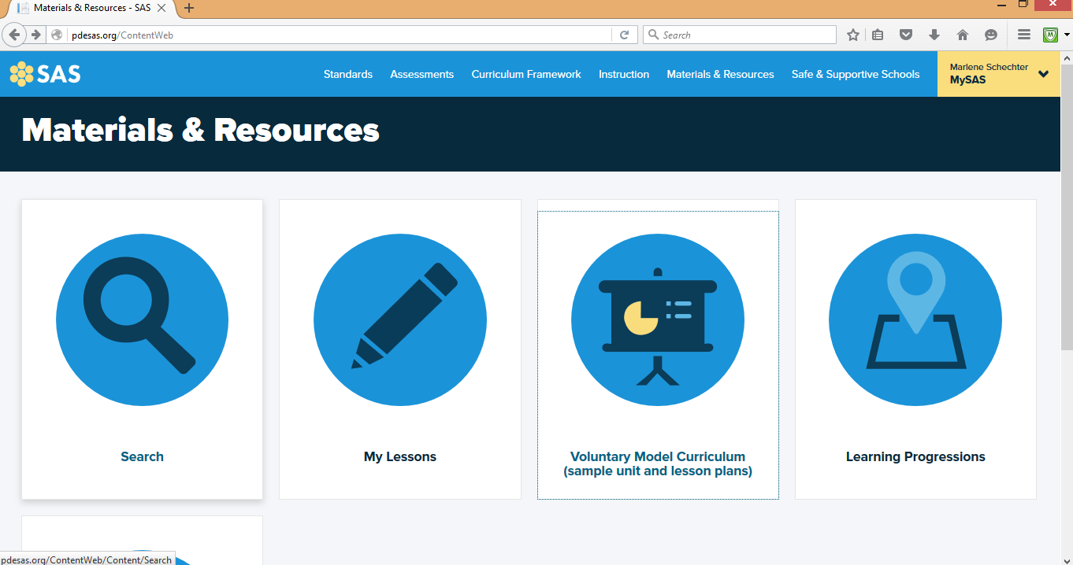

Slide 28
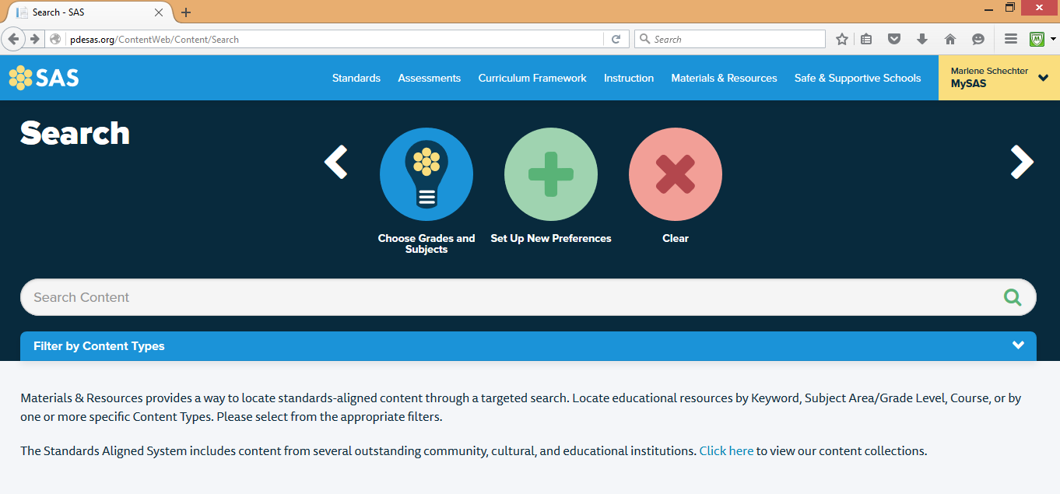

Slide 29
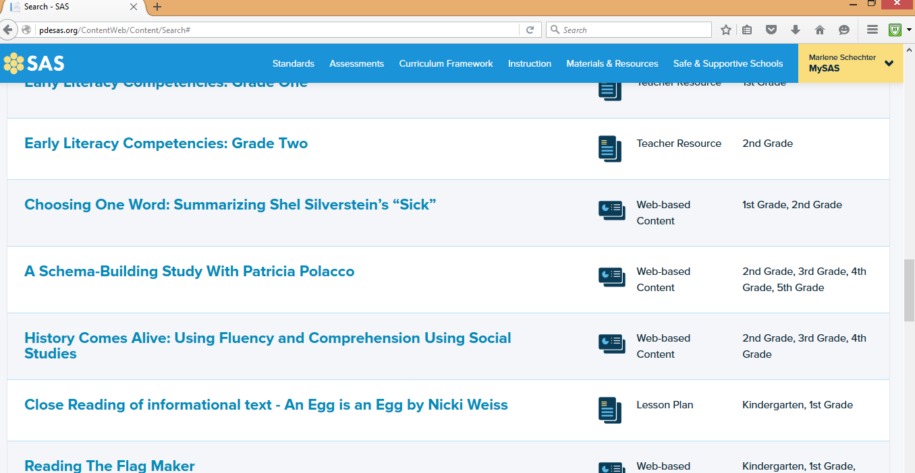

Slide 30
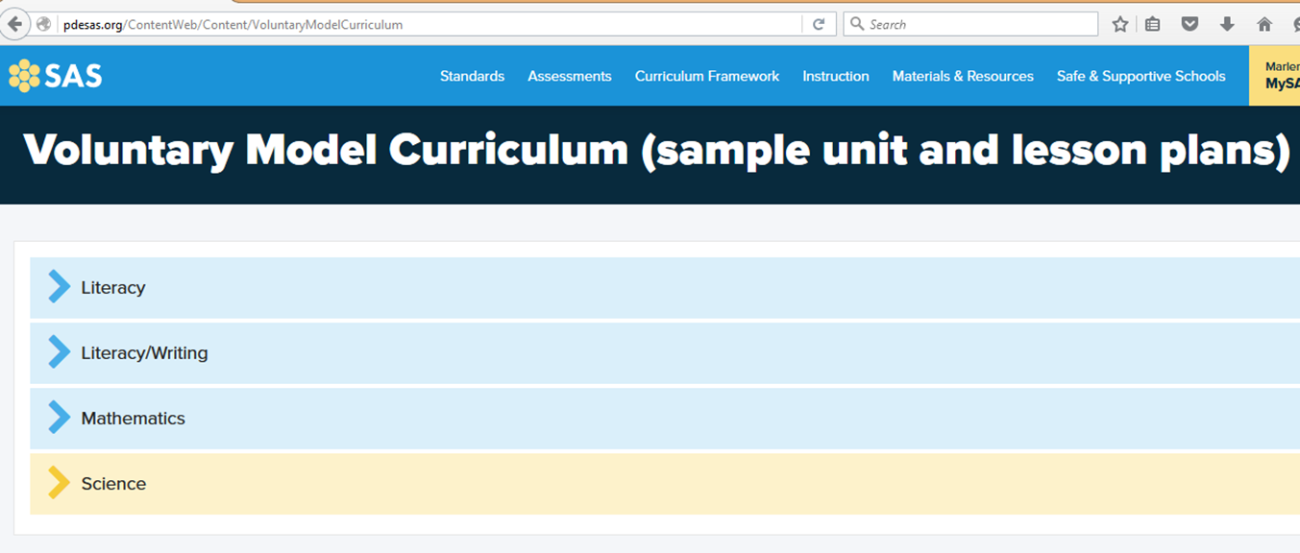
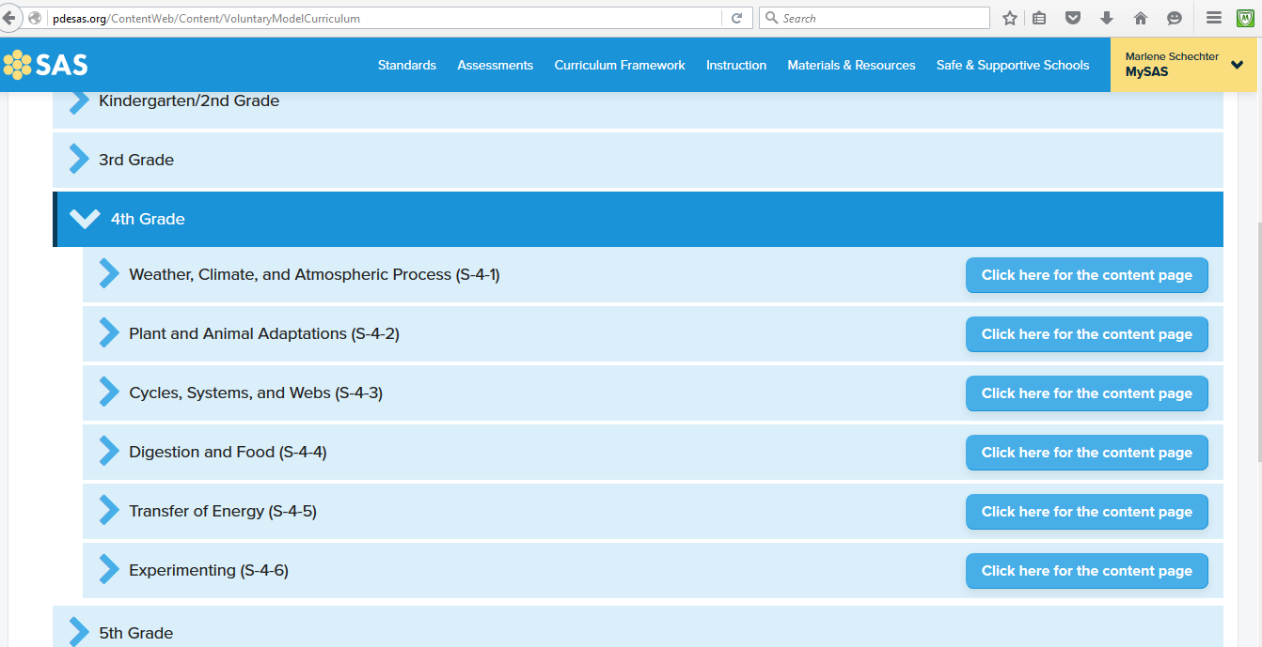
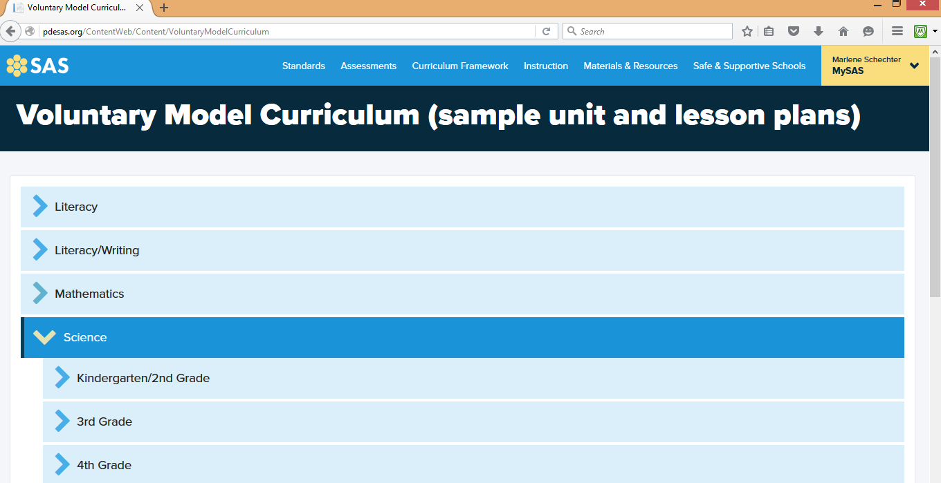

Slide 31
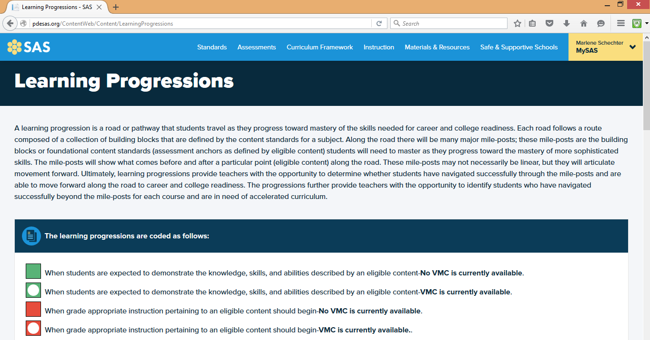

Slide 32
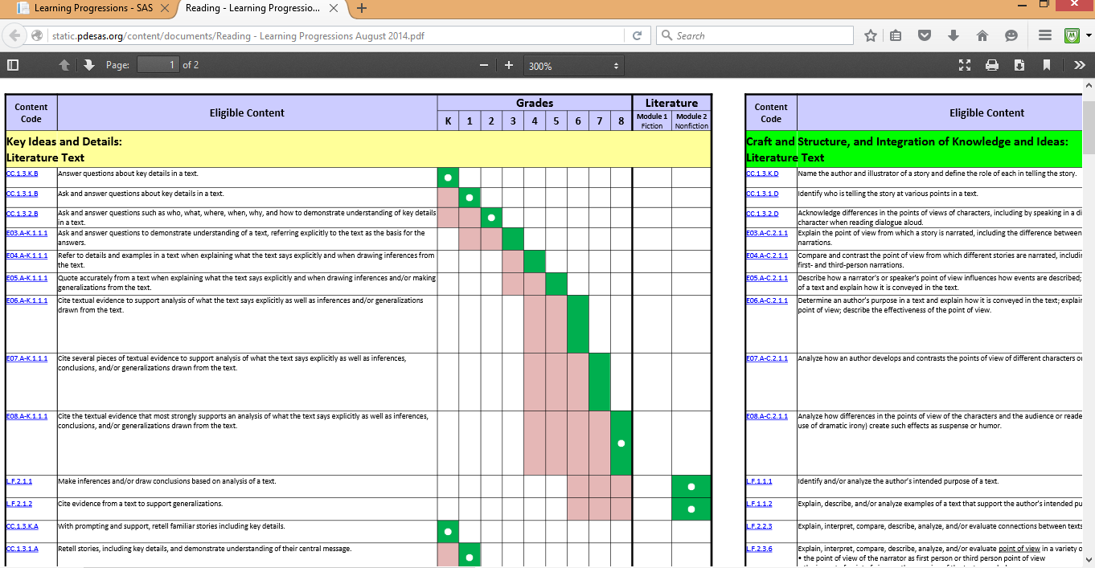

Slide 33
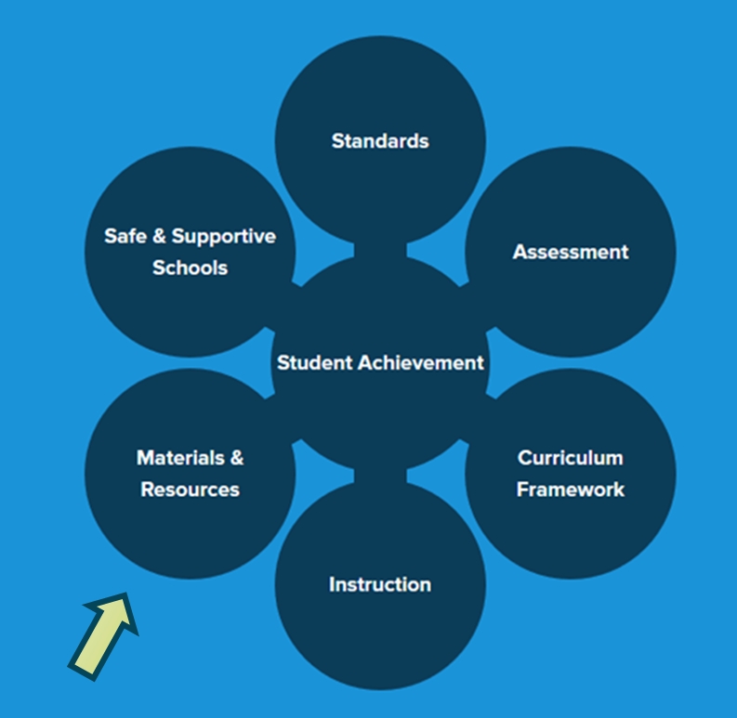
How Can I Use ‘Materials & Resources’ in my teaching?

Slide 34
Safe & Supportive Schools
Supplies resources and exemplars to promote active student engagement in a safe and positive learning environment. Areas within the element include the following:
  Engagement
  Safety
  Environment
Act 126 information
Educator Dashboard Early Warning System (EWS) - a free, voluntary tool

Slide 35
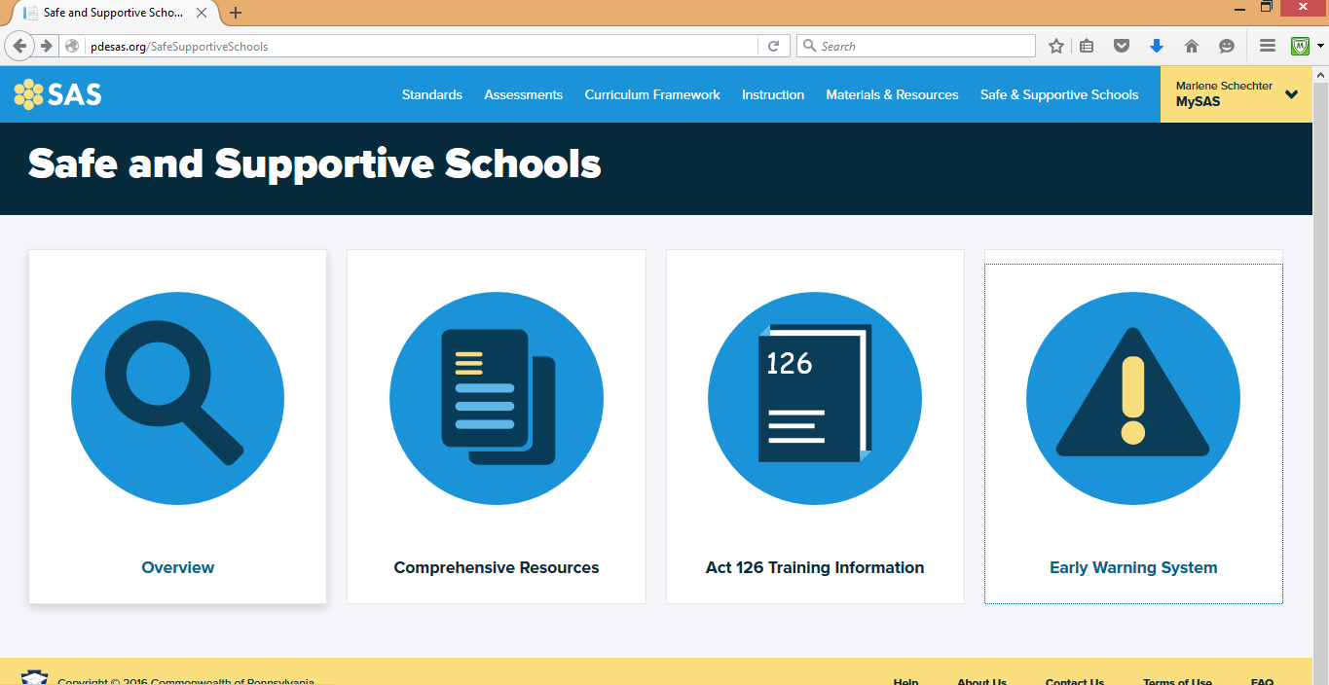

Slide 36
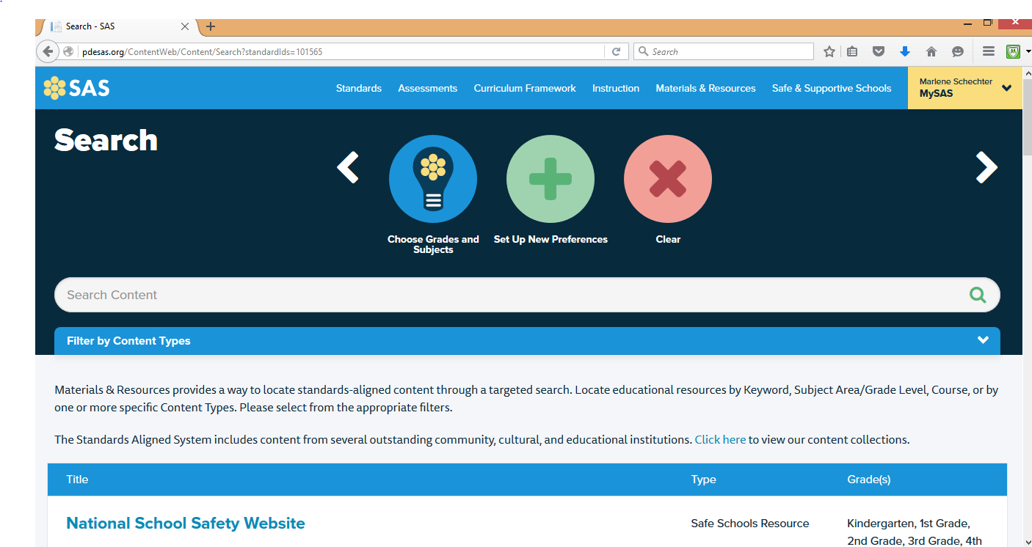

Slide 37
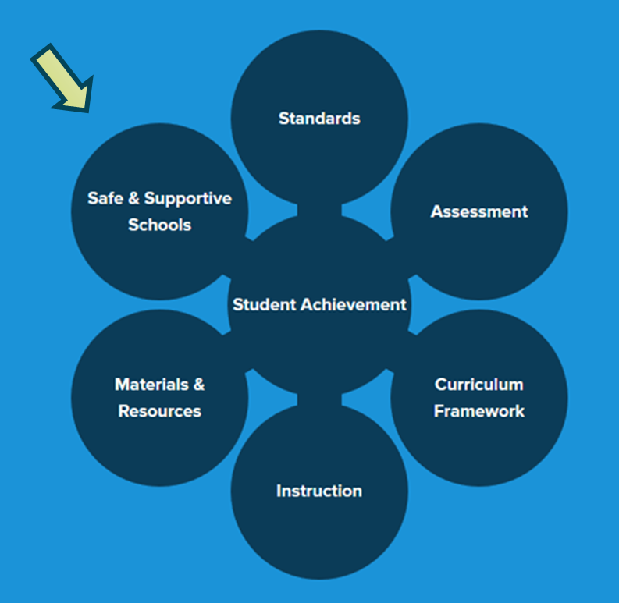
How Can I Use ‘Safe & Supportive Schools’ in my teaching?

Slide 38
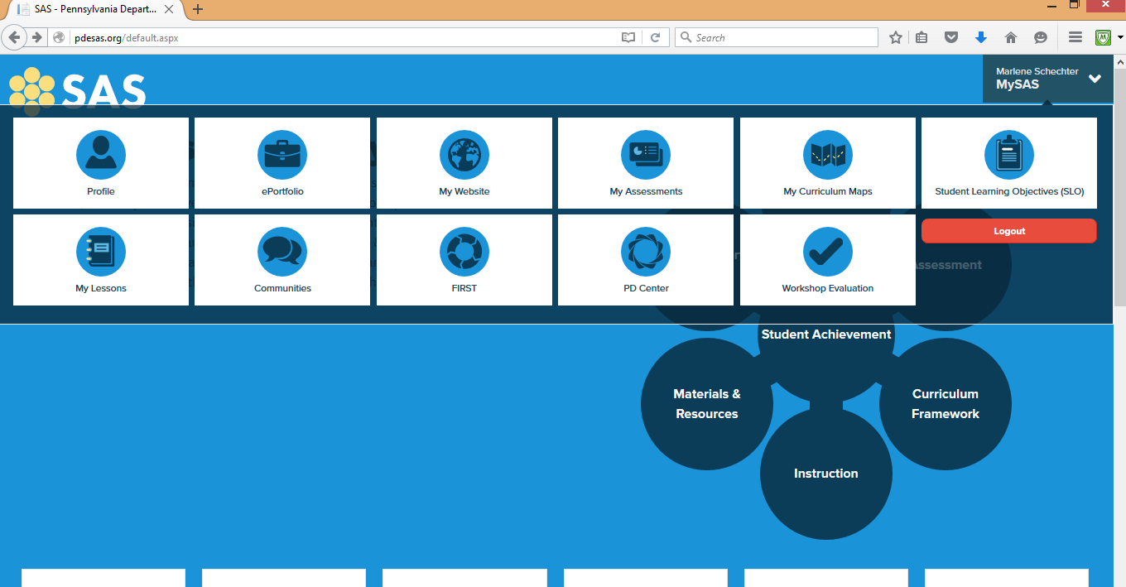

Slide 39
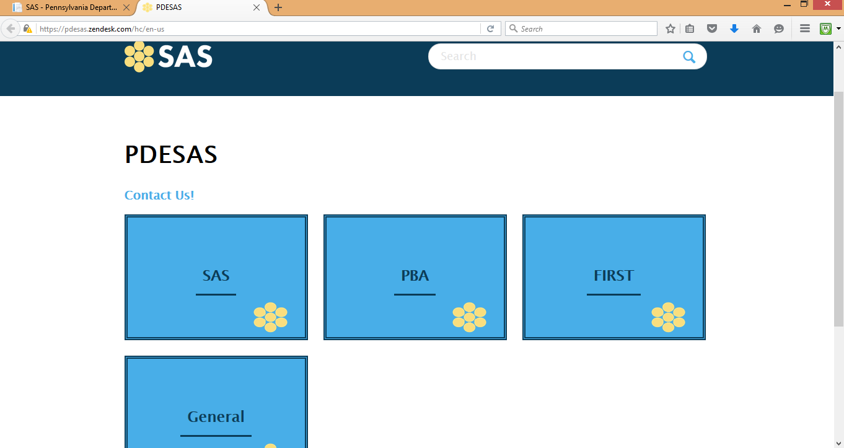

Slide 40
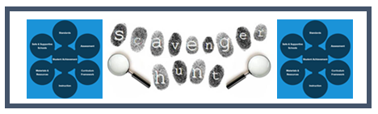
Application and Practice Navigating SAS

